Slide 1
Interesting results

Slide 2
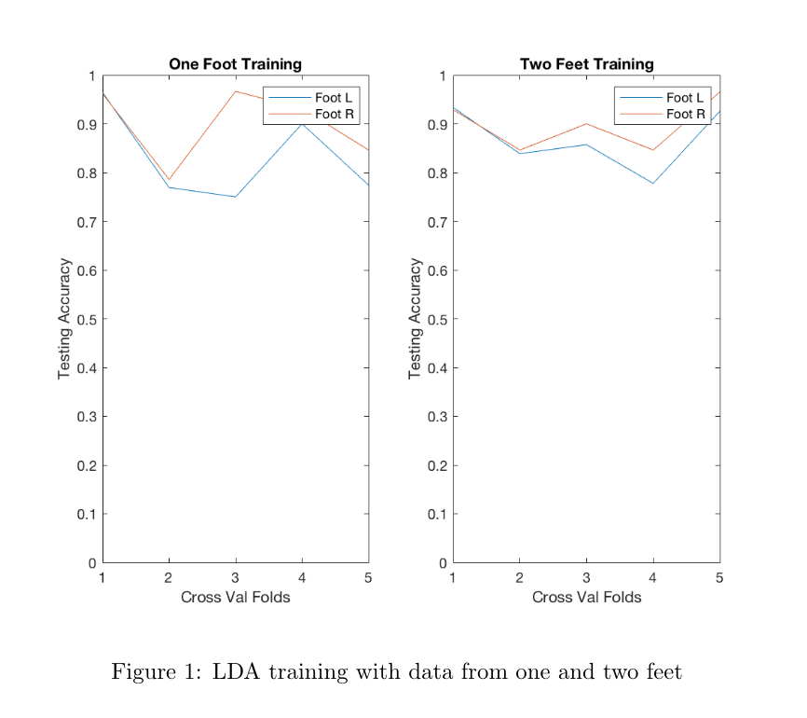
LDA for Terrain Prediction
Very similar to Roman’s, but using data from one or two feet; no difference really between 1 vs 2 feet

Slide 3
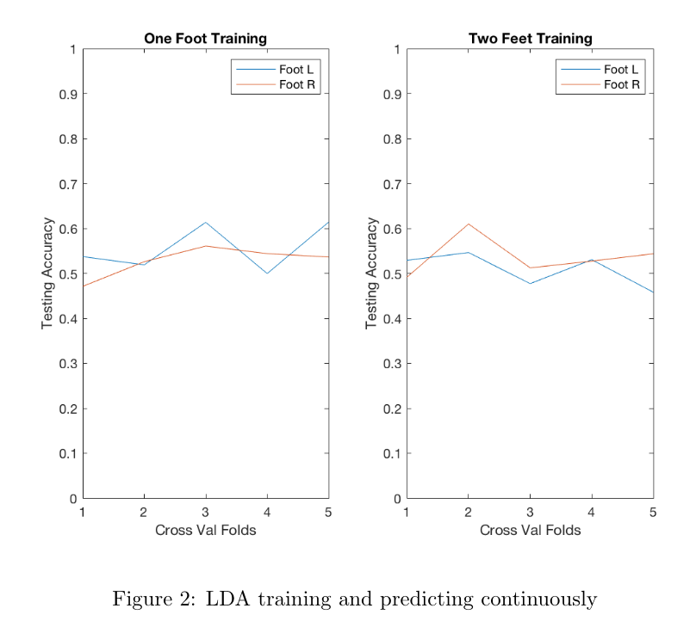
Continuous predictions with LDA
Predict continuously on window sizes of 10
Predictions were clearly not great (but slightly better than random)

Slide 4
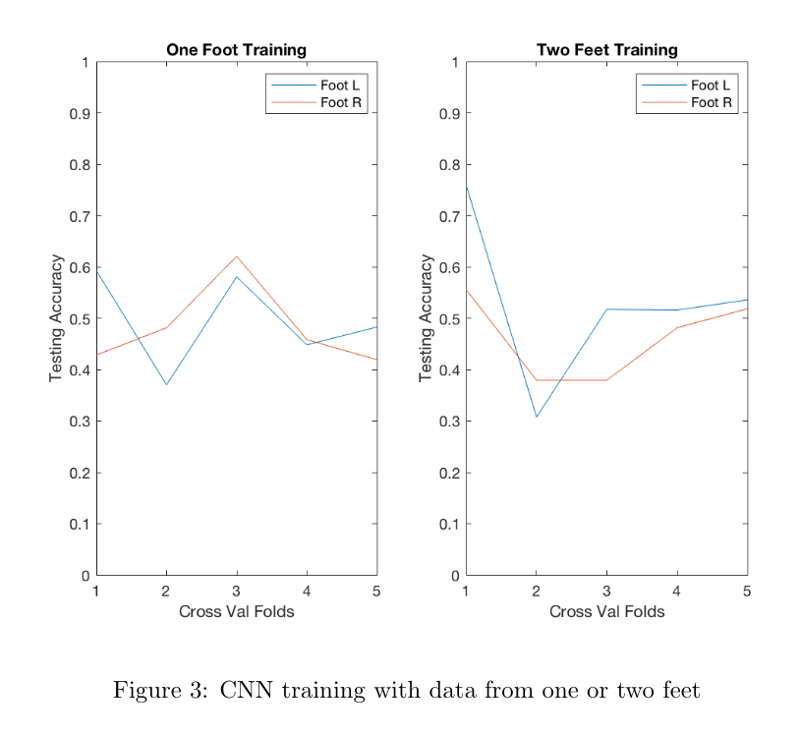
CNN for Terrain Prediction
Very simple CNN over 10x6x1 input size (the same 10 time-points the LDA uses for predictions)

Slide 5
Stride time prediction
Problem: my data doesn’t have ankle angle, so there’s not great way to know when a new stride is occurring (i.e. finding heel strike)
I can find it pretty well setting thresholds, but those thresholds are dependent on terrain
Need a terrain independent way to see at what point the stride is at
(Obviously can also get new data with ankle angle, but stride time prediction could be useful in general)

Slide 6
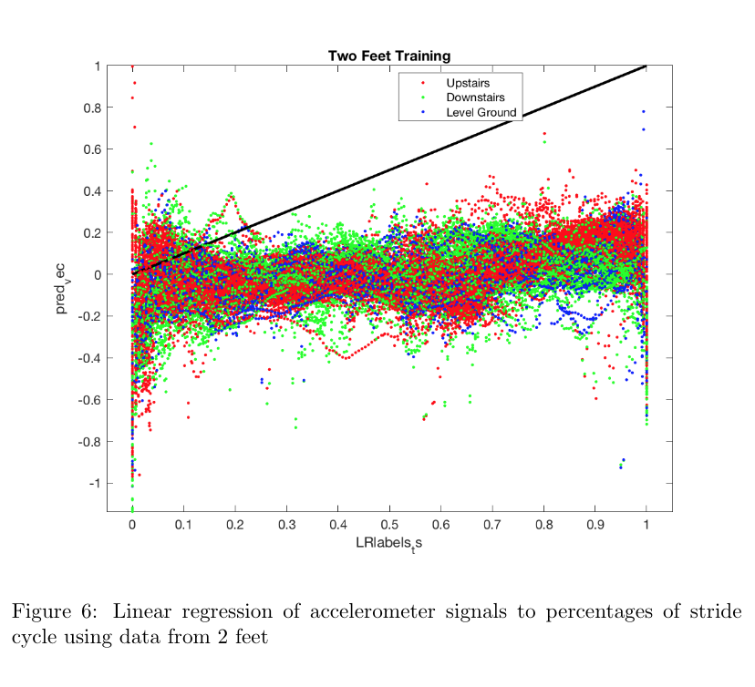
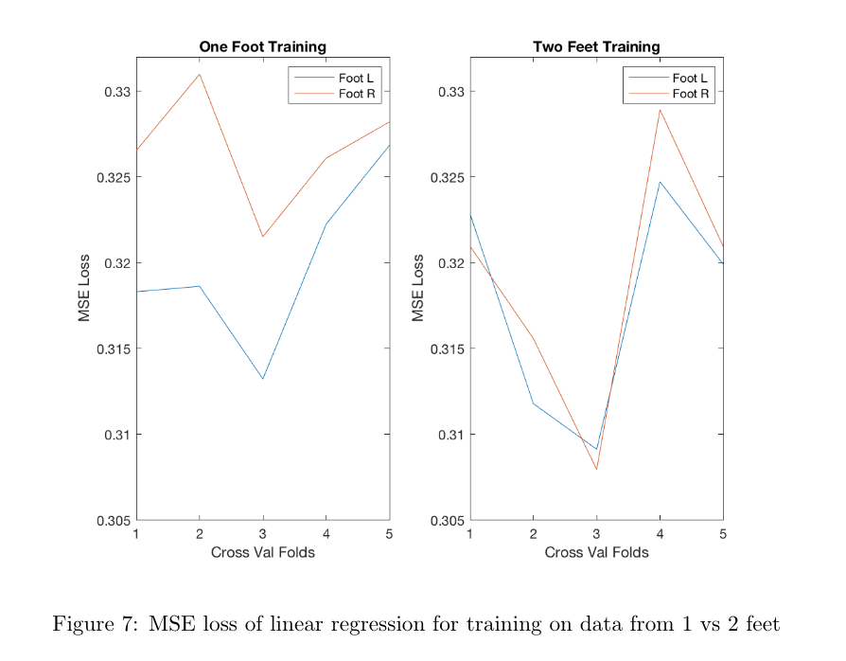
Simple linear regression
Regress raw signal data points to point in stride cycle & predict on testing data
Here, training on two feet seems to maybe decrease loss

Slide 7
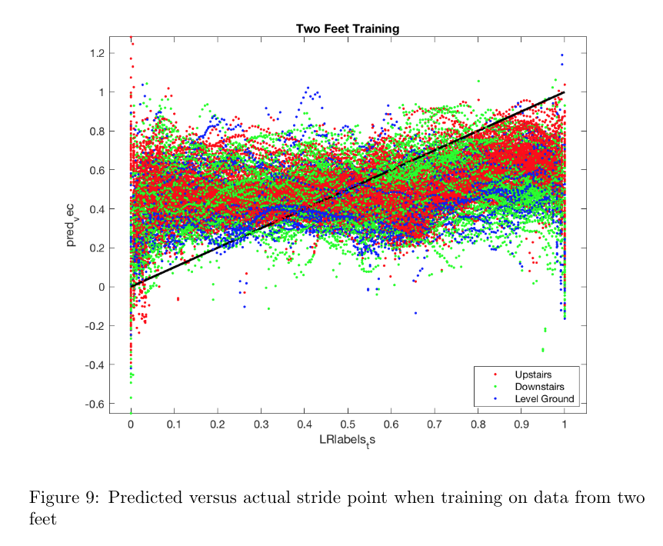
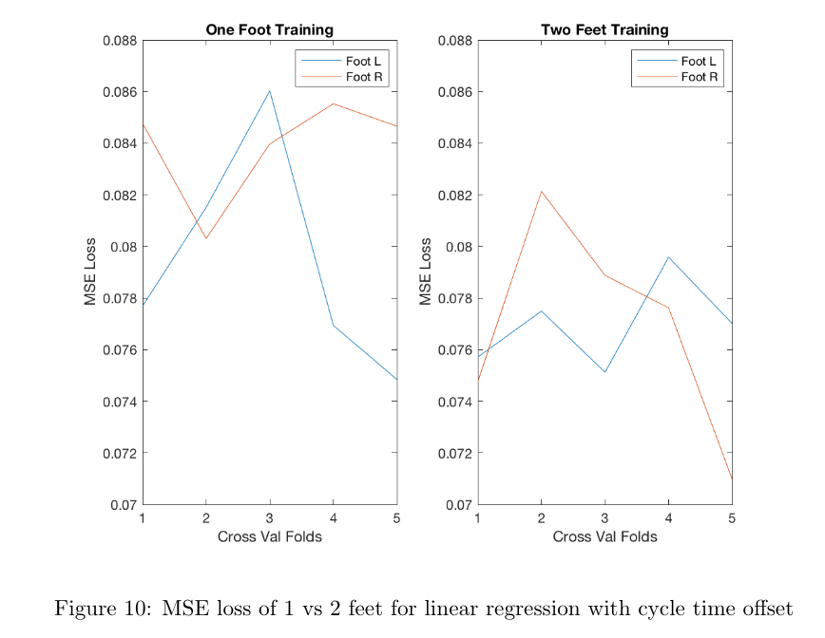
Linear Regression with Previous Cycle Time Offset
Add offset of previous cycle time to training data
Predictions look better, training on two feet clearly decreases loss, and loss is much lower than simple linear regression

Slide 8
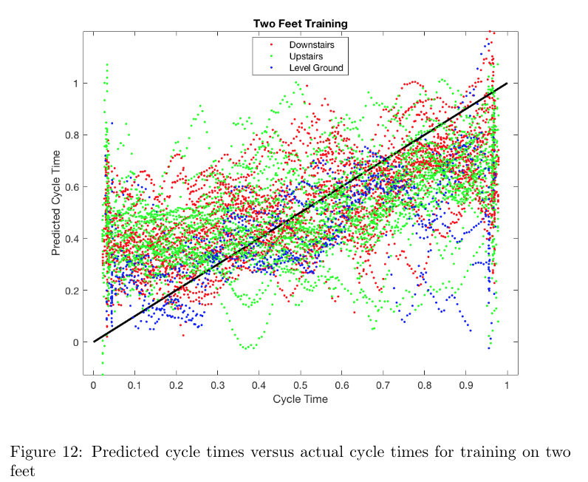
Linear regression with previous cycle time offset and averaging
The idea here was to correlate a larger portion of the stride with a stride time by correlating the mean, max, and range of 10 timepoints with the stride time of the median timepoint
Predictions look a bit better
Loss was similar to above

Slide 9
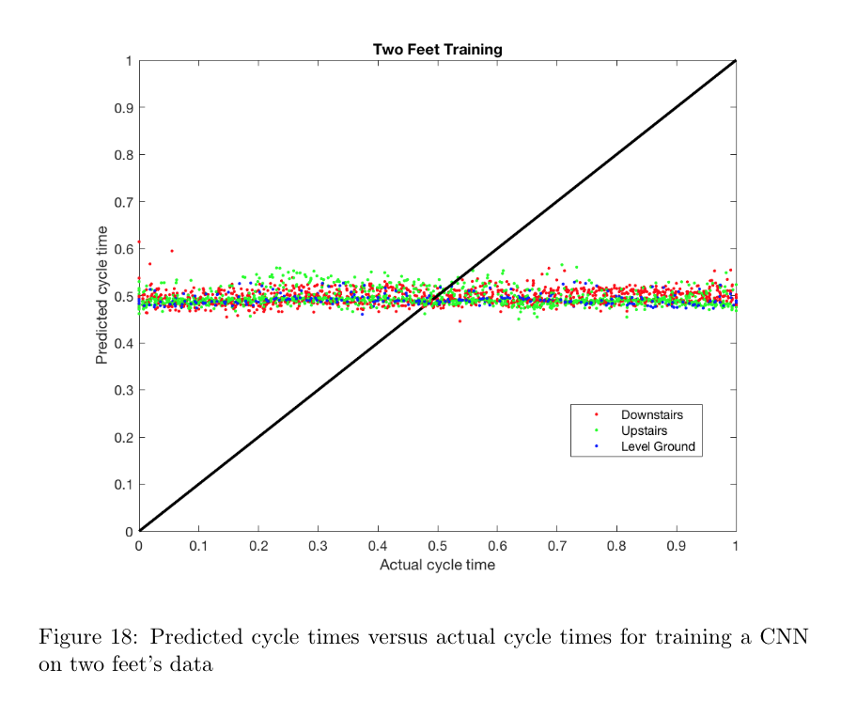
CNN to predict stride time
Similar to the averaging idea, the idea was to correlate 10 time-points to a stride time (this time with a CNN instead of averaging)

Slide 10
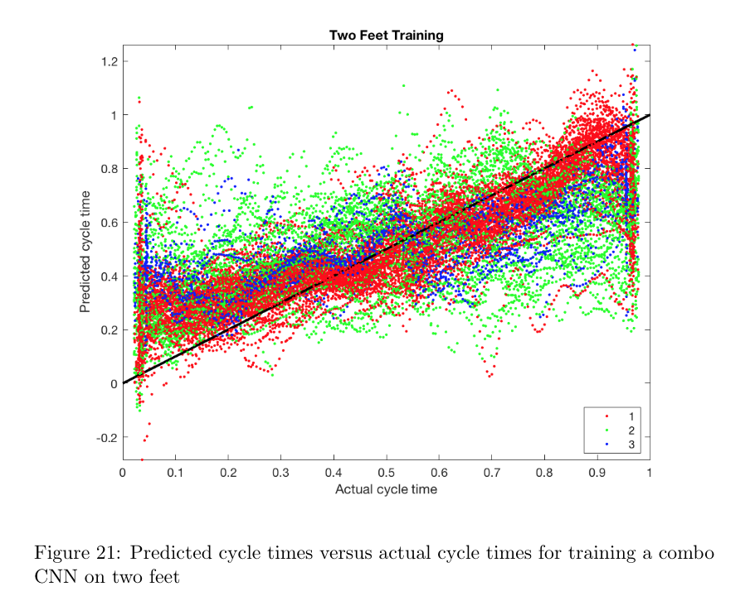
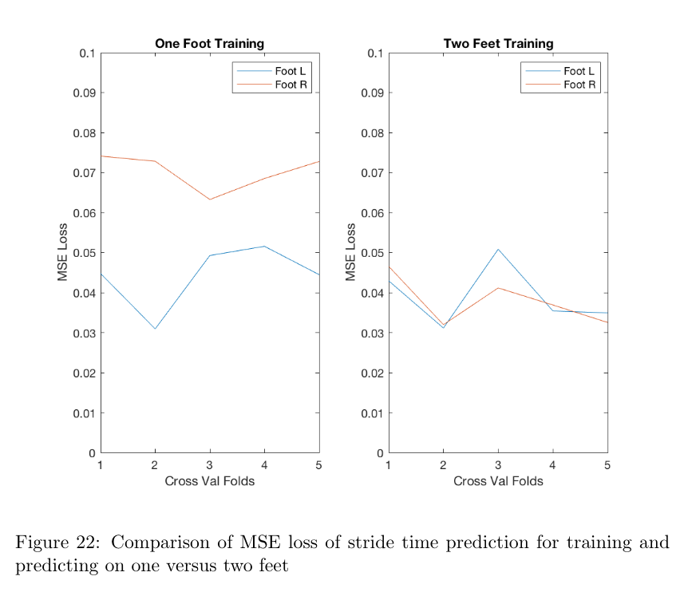
Combo CNN
This CNN predicts both stride time and terrain.
Terrain accuracy was barely better than random (not shown), but stride time prediction was pretty good, which was pretty interesting especially in the context of the previous model

Slide 11
To Do
More data obviously needed for any sort of deep learning
More balanced data (due to exo breaking, I have way less level ground walking then anything else)
Make sure to sample at 1000 Hz, not 100

